Slide 1
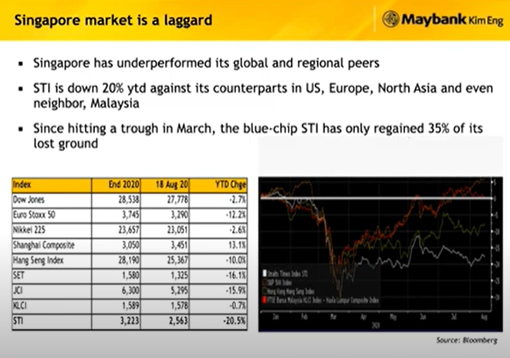

Slide 2
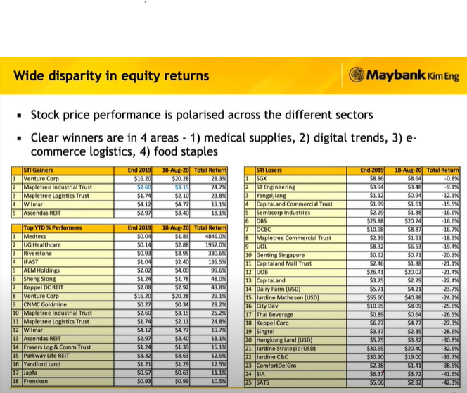

Slide 3
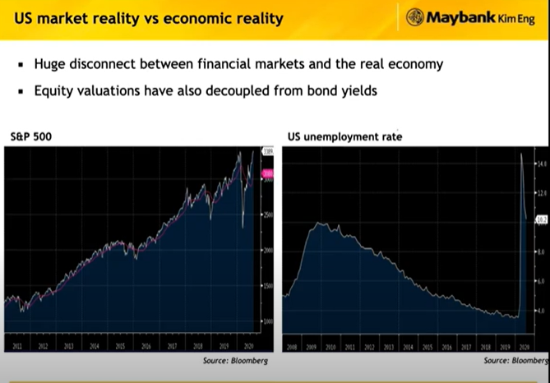

Slide 4
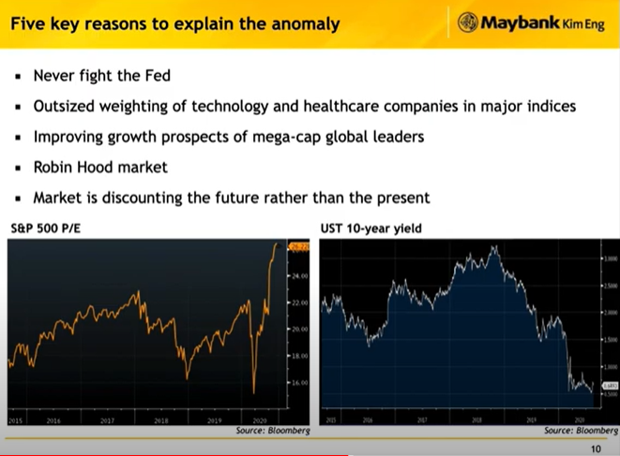

Slide 5
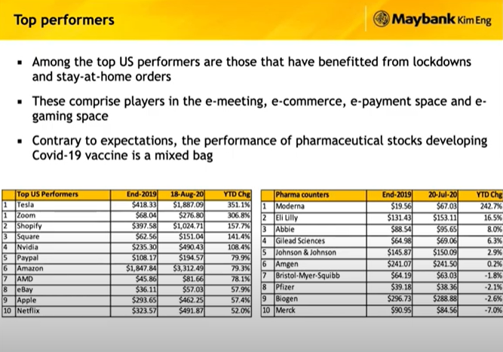

Slide 6
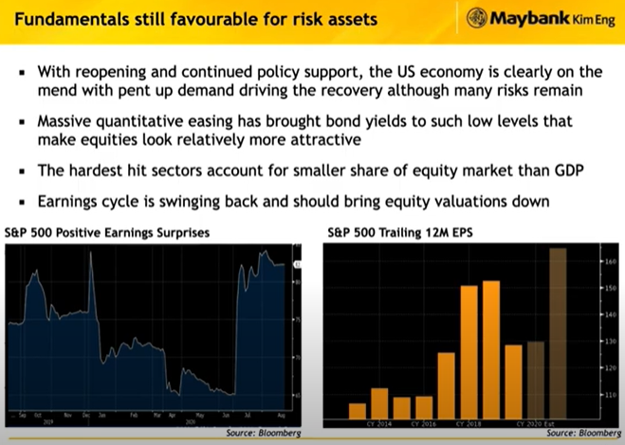

Slide 7
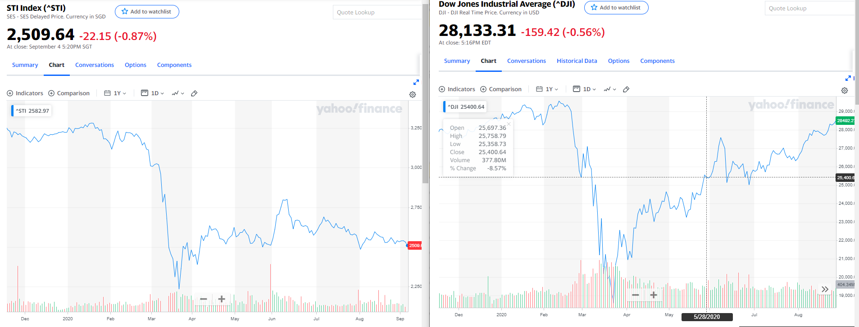
Comparison of markets (STI vs US) (1)
US is over-value -> PE ratio chart (2)
STI is under-value -> PE ratio chart (2)
Opportunity in Singapore (STI) (2)
Zoom in to industry – How? Screening to find this [Research] (3)
Technology
Healthcare
Transport
Pick one stock -> insider transaction and value of the stock (PE, latest earnings) (4-6)
Pick one more? (?)
Recommendation (9)
Technology research (How to use markdown, visualisation?)

